Slide 1
Web based Programming
1.Fundamentals

Slide 2
1.1 A Brief Intro to the Internet (1)
Origins
  ARPAnet – late 1960s and early 1970s
    Network reliability as one fundamental requirement
    For ARPA-funded research organizations
  BITnet, CSnet – late 1970s & early 1980s
    Email and file transfer for other institutions
  NSFnet – 1986
    Initially connected five NSF-funded supercomputer centers
    By 1990, it had replaced ARPAnet for non-military uses
    Soon became the network for all (by the early 1990s)
  NSFnet eventually became known as the Internet
What the Internet is:
  A world-wide network of computer networks
  At the lowest level, since 1982, all connections use TCP/IP
  TCP/IP hides the differences among devices connected to the
  Internet
  In most cases, a higher-level protocol runs on top of TCP/IP

Slide 3


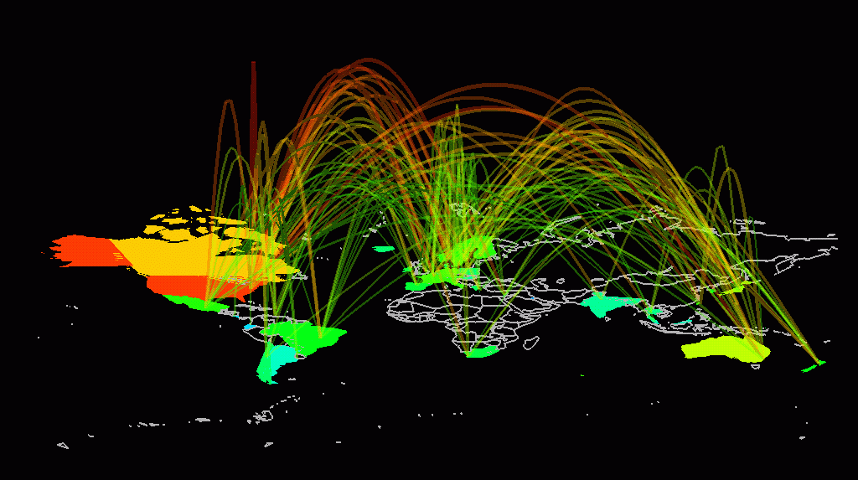
1.1 A Brief Intro to the Internet (2)
Internet Protocol (IP) Addresses
  Every node has a unique numeric address
  Form: 32-bit binary number, usually written as four 8-bit numbers separated by periods, e.g., 155.69.146.228
  New standard, IPv6, has 128 bits (1998)

Slide 4


1.2 The World-Wide Web
Origins
  Tim Berners-Lee at CERN proposed the Web in 1989
    Purpose: to allow scientists to have access to many databases of documents describing scientific work through their own computers
    Document form: hypertext
    Pages/Documents/Resources
  Hypermedia – more than just text – images, sound, etc.

Slide 5


1.2 The World-Wide Web
Web or Internet?
  The Internet is a collection of computers and other devices connected by equipment that allows them to communicate with each other
  The Web is a collection of software and protocols on the Internet (e.g., HyperText Transfer Protocol (HTTP), telnet, ftp)

Slide 6



1.3 Client-Server Programming
HTTP request
GET http://ntu.edu.sg HTTP/1.1
……
User request from browser
http://www.ntu.edu.sg
Client
Server
HTTP response
HTTP/1.1 200 OK
……
Browser display

Slide 7
1.4 Domain Name System (DNS)
Domain Names
  Textual names of computers on the Internet
  Form: host-name.domain-names e.g. www.sce.ntu.edu.sg
  First domain is the smallest; last is the largest
  Last domain specifies the country or type of organization
  Fully qualified domain name – the host name and all of the domain names
  DNS servers – convert fully qualified domain names to IPs

Slide 8
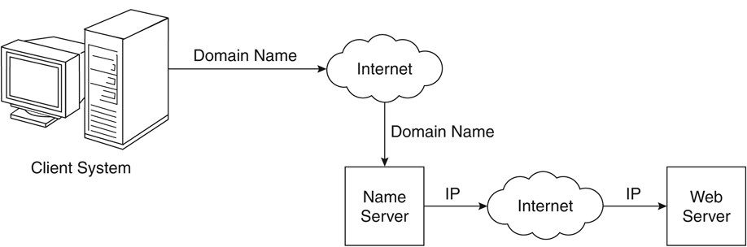
1.4 Domain Name System (DNS)
Domain name conversion

Slide 9
1.5 Uniformed Resource Locators (URL)
General form: scheme:object-address
  The scheme is often a communication
  protocol, such as http, telnet, ftp
For the http protocol, the object-address is:
  //fully-qualified-domain-name/doc-path
  http://www.ntu.edu.sg/pages/home
URLs cannot include spaces or any of a collection of other special characters (semicolons, colons, ...)
If the doc-path ends with a slash, it means it is a directory

Slide 10
1.6 Web Servers
Provide responses to browser requests, either existing documents or dynamically built documents
Web servers run as background processes in the operating system
  Monitoring a communication port on the host, accepting HTTP messages when they appear
Typical Web servers
  Apache (open source, fast, reliable)
  IIS (run under Microsoft Windows)

Slide 11
1.7 The Hyper Text Transfer Protocol
HTTP request
GET http://ntu.edu.sg HTTP/1.1
……
Client
Server
HTTP response
HTTP/1.1 200 OK
……

Slide 12
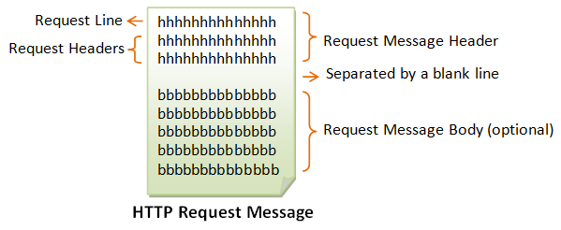
1.7 The Hyper Text Transfer Protocol
HTTP Request
  Form: HTTP-method doc-path-URL HTTP-version
  Header fields
  blank line
  Message body (optional)

Slide 13
1.7 The Hyper Text Transfer Protocol
HTTP Request
  Form: HTTP-method doc-path-URL HTTP-version
  Header fields
  blank line
  Message body (optional)
  An example of the first line of a request:
  GET /pub/WWW/TheProject.html HTTP/1.1
Most commonly used methods:
  GET – Fetch a document
  POST – Execute the document, using the data in body (now mainly used for form data processing)
  HEAD – Fetch just the header of the document
  PUT – Store a new document on the server
  DELETE – Remove a document from the server

Slide 14
1.7 The Hyper Text Transfer Protocol
Common request header fields:
  Accept: text/plain (specify browser’s preference for the MIME type of the requested document)
  Accept: text/*
  If-Modified-Since: date (send the requested document only if it has been modified since the given date)
  Content-Length: number of bytes (for POST request)
  Content-Type: text/html (for POST request)
  ……
Type specifications: type/subtype
  E.g. text/plain, text/html, image/gif, image/jpeg

Slide 15
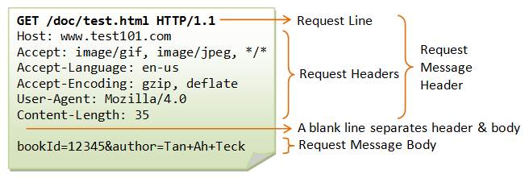
1.7 The Hyper Text Transfer Protocol

Slide 16
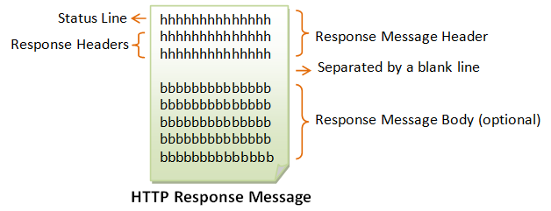
1.7 The Hyper Text Transfer Protocol
HTTP Response
  Form: Status line
  Response header fields
  blank line
  Response body (optional)

Slide 17
1.7 The Hyper Text Transfer Protocol
HTTP Response
  Form: Status line
  Response header fields
  blank line
  Response body (optional)
  Status line format:
  HTTP-version status-code explanation
    Example: HTTP/1.1 200 OK
    Status code is a three-digit number

Slide 18
100 Continue: The server received the request and in the process of giving the response.
200 OK: The request is fulfilled.
301 Move Permanently: The resource requested for has been permanently moved to a new location. The URL of the new location is given in the response header called Location. The client should issue a new request to the new location.
302 Found & Redirect (or Move Temporarily): Same as 301, but the new location is temporarily in nature. The client should issue a new request, but applications need not update the references.
304 Not Modified: In response to the If-Modified-Since conditional GET request, the server notifies that the resource requested has not been modified.
400 Bad Request: Server could not interpret or understand the request, probably syntax error in the request message.
401 Authentication Required: The requested resource is protected, and require client’s credential (username/password).
403 Forbidden: Server refuses to supply the resource, regardless of identity of client.
404 Not Found: The requested resource cannot be found in the server.
405 Method Not Allowed: The request method used, e.g., POST, PUT, DELETE, is a valid method. However, the server does not allow that method for the resource requested.
408 Request Timeout:
414 Request URI too Large:
500 Internal Server Error: Server is confused, often caused by an error in the server-side program responding to the request.
501 Method Not Implemented: The request method used is invalid (could be caused by a typing error, e.g., "GET" misspell as "Get").
502 Bad Gateway: Gateway indicates that it receives a bad response from the upstream server.
503 Service Unavailable: Server cannot response due to overloading or maintenance. The client can try again later.
504 Gateway Timeout: Gateway indicates that it receives a timeout from an upstream server.

Slide 19
1.7 The Hyper Text Transfer Protocol
HTTP Response
  Form: Status line
  Response header fields
  blank line
  Response body (optional)
  Status line format:
  HTTP-version status-code explanation
    Example: HTTP/1.1 200 OK
    Status code is a three-digit number
    403 Forbidden, 404 Not Found, 500 Internal Server Error

Slide 20
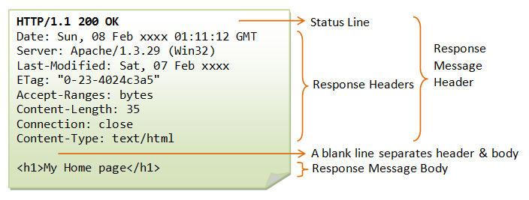
1.7 The Hyper Text Transfer Protocol

Slide 21
1.8 The Web Programmer’s Toolbox (1)
HTML and XHTML
  To describe the general form and layout of documents
  An HTML document is a mixture of content and controls
    Controls are specified by tags and their attributes
  XHTML is nothing more than HTML with stronger syntactic rules

Slide 22
1.8 The Web Programmer’s Toolbox (2)
JavaScript
  A client-side HTML-embedded scripting language
  Dynamically typed and not object-oriented
  Provide a way to access elements of HTML documents and dynamically change them
PHP
  A server-side scripting language
  Similar to JavaScript
  Great for form processing and database access through the Web
Flash, Ajax, .NET, …

Slide 23
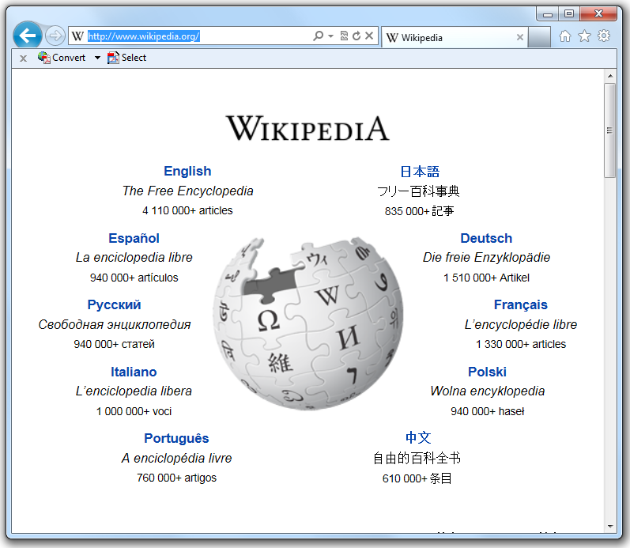
A journey in the Internet

Slide 24
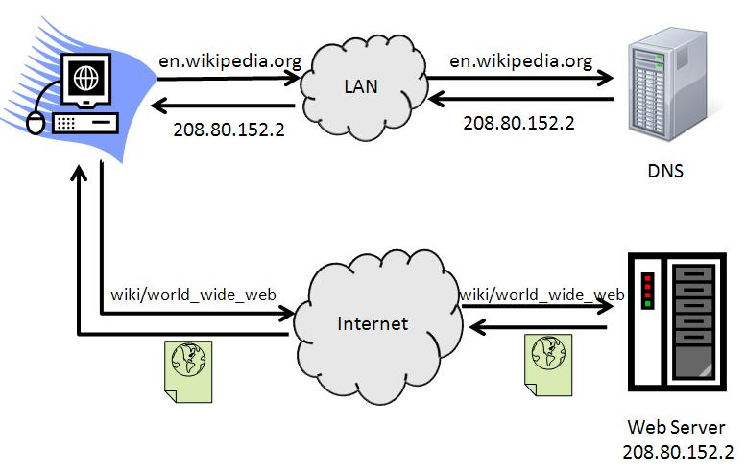
A journey in the Internet
Preamble
MAC
Application
IP
TCP
Transport
HTTP Request
Network
Link
Physical
TCP: source port #; dest port # (default 80)
IP: URL => IP address
  DNS server
MAC: IP address => MAC address
  ARP: Address Resolution Protocol

Slide 25



A journey in the Internet
Application
Transport
Network
Link
Physical
ACK

Slide 26
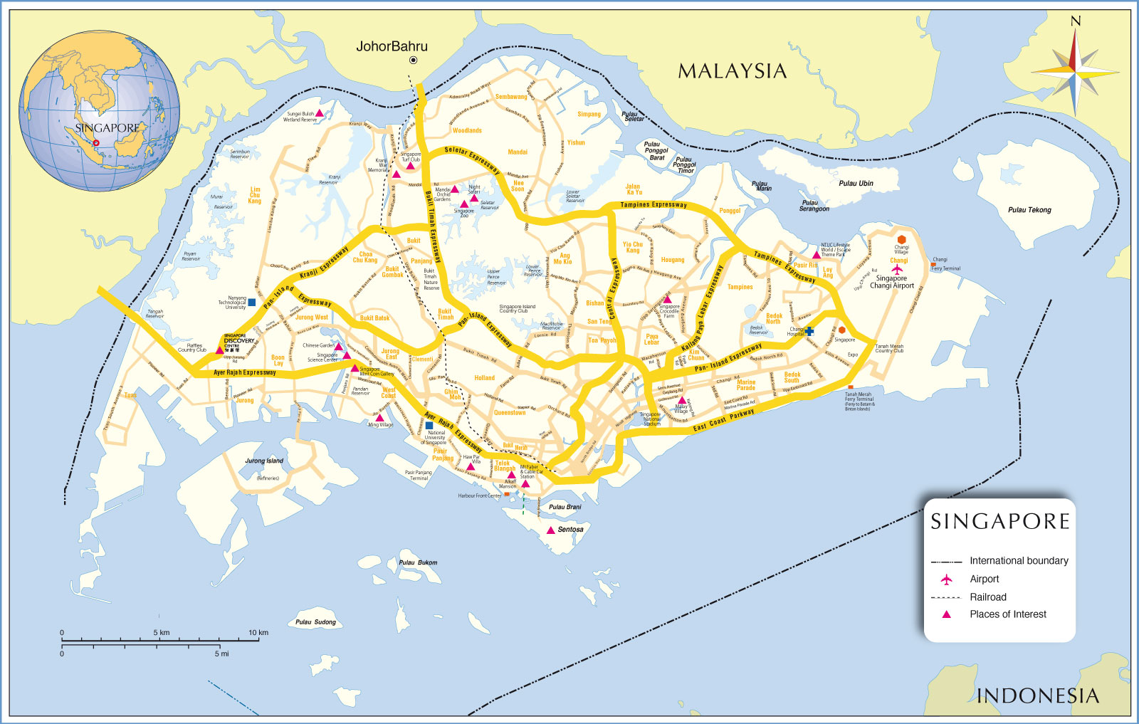



A journey in the Internet
Application
Transport
Network
Network
Network
Link
Link
Link
Physical
Intra-domain routing
  Distance vector routing (e.g., RIP)
  Link state routing (e.g., OSPF)

Slide 27

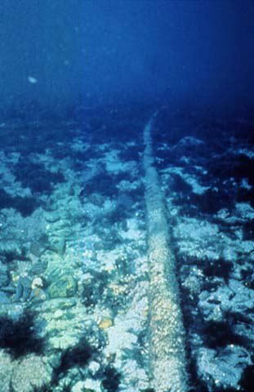
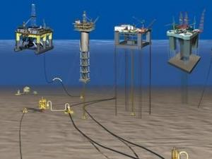
A journey in the Internet
Inter-domain routing
  BGP (border gateway protocol)
Application
Transport
Network
Link
Physical

Slide 28


A journey in the Internet
Inter-domain routing
  BGP (border gateway protocol)
Application
Transport
Network
Link
Physical
Wiki server: 208.80.152.2
ACK

